Slide 1




HospitalData Analysis
Submitted by :Dipali V Agrawal
Guided by :Sumit Sir

Slide 2

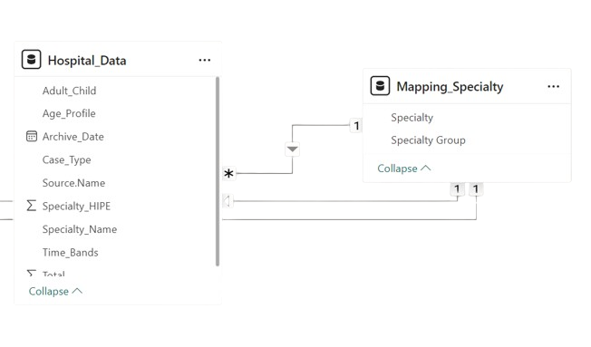
Data Models
Data modelling is process of analyzing and defining data types and relationship between data in different table
The diagram shows two connected data tables: "Hospital Data" and "Mapping Specialty." "Hospital Data" contains various hospital-related information like case types, specialties, and age profiles. "Mapping Specialty" provides a breakdown of specialties into groups.

Slide 3
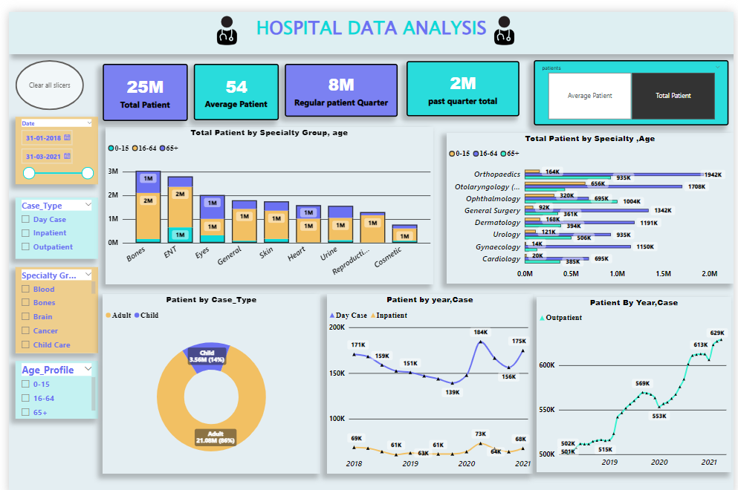
Dash Board

Slide 4

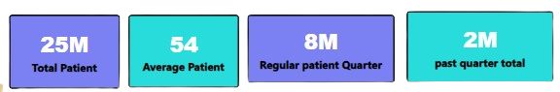
Key Overview/Measures
Measures are used in Power BI to perform calculations on data and create powerful data analysis .
Measure 1: Total Patients (25M)
This measure shows the total number of patients, 25 million, handled by the system over a certain period. It represents the full volume of patients who received care across various specialties.
Measure 2: Average Patients (54)
The measure highlights the average number of patients, 54, reflecting an average patient load for a specific timeframe. It gives insight into typical patient numbers per day or per unit.
Measure 3: Regular Patients Per Quarter (8M).
This measure indicates the regular patient count per quarter, reaching 8 million.
Measure 4: Past Patients Per Quarter (8M).
This measure indicates the past patient count per quarter, reaching 2 million.

Slide 5

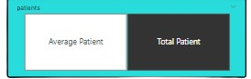
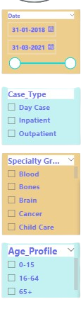
Slicers
Slicers in Power BI are interactive filters used to filter data in a report or dashboard.
Date Slicer: Filters data based on a selected date range,
allowing users to focus on a specific time period.
Case Type Slicer: Filters data by case types (Day Case, Inpatient, Outpatient) to analyze specific patient categories.
Specialty Group Slicer: Filters data by medical specialties (Blood, Bones, Brain, etc.) to examine specific treatment areas.
Age Profile Slicer: Filters data by age groups (0-15, 16-64, 65+) to focus on different patient demographics.

Slide 6



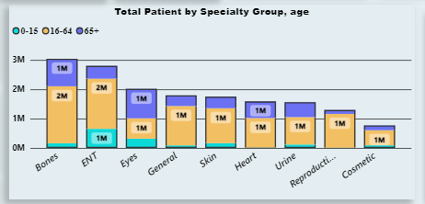
01
Stacked Column Chart
The chart shows the number of patients in different age groups for various medical specialties. The x-axis lists the specialties (Bones, ENT, Eyes, etc.), and the y-axis shows the number of patients. Each bar represents a specialty, and the different colors within each bar represent different age groups. For example, the blue part of a bar might represent patients aged 0-15.

Slide 7

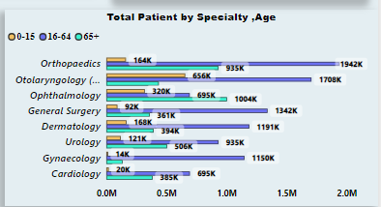
02
Clustered Bar Chart
The chart shows the number of patients in different age groups for various medical specialties. The x-axis lists the specialties (Orthopedics, Dermatology, etc.), and the y-axis shows the number of patients. Each bar represents a specialty, and the different colors within each bar represent different age groups. For example, the blue part of a bar might represent patients aged 0-15.

Slide 8

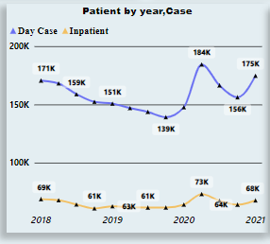
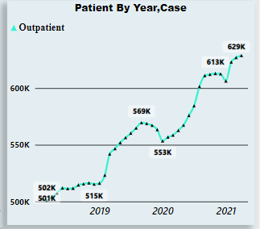
03
Line Charts
Day Case
A day case is a patient who receives care or treatment in a hospital for a procedure and is released on the same day
Inpatient
A person who goes into hospital to receive medical care and stays there one or more nights while they are being treated.
Outpatient
A person who goes to a hospital for treatment, but who does not stay any nights there
The chart shows the number of day cases and inpatient cases over four years. The x-axis represents the years (2018-2021), and the y-axis represents the number of cases. The blue line represents day cases, and the orange line represents inpatient cases. The chart shows that the number of day cases and inpatient cases fluctuated over the years.
The chart shows the number of outpatient cases over four years. The x-axis represents the years (2019-2021), and the y-axis represents the number of cases. The line shows that the number of outpatient cases increased each year.

Slide 9

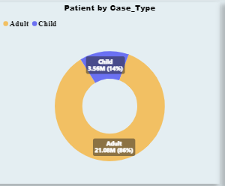
04
Donut Chart
The chart shows the distribution of patients by age group. The yellow section represents adults, and the blue section represents children. The chart shows that most patients are adults (86%), while a smaller percentage are children (14%).

Slide 10
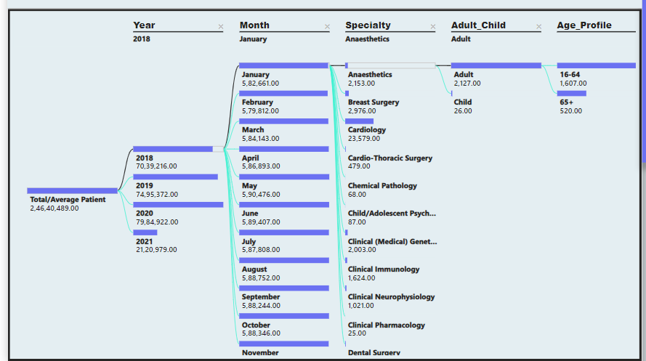
Hospital Data Tree
The chart shows the number of patients for different specialties, age groups, and patient types (adult or child) over four years and several months. Each branch of the tree represents a specific year, month, or specialty. The numbers at the end of each branch indicate the number of patients in that category. For example, the branch for "2018 - January - Anaesthetics - Adult - 16-64" shows that there were 1,607 adult patients aged 16-64 who received anesthesia services in January 2018

Slide 11

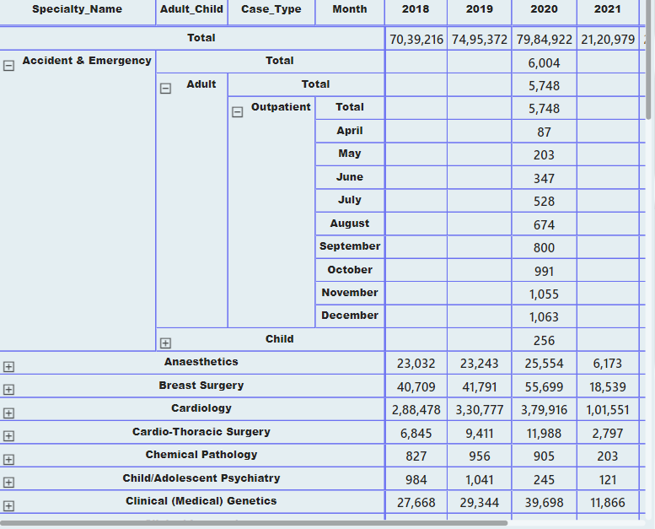
Data Table
The table shows the number of patients for different specialties, age groups, and patient types (adult or child) over four years (2018-2021). Each row represents a specific specialty, and each column represents a year. The numbers in the table indicate the number of patients in each category. For example, the cell at the intersection of the "Accident & Emergency" row and the "2018" column shows that there were 70,39,216 patients in the Accident & Emergency department in 2018.

Slide 12


THANK YOU!

